Slide 1
Query | Filter Expression
All mail messages with subject "Product Roadmap" | "[Subject] = 'Product Roadmap'"
All mail messages with subject "Turn I can't into I can" | "[Subject] = 'Turn I can''t into I can'" (add a single quote as an escape character)
All mail messages with subject "Job application: "Business Analyst" position" | "[Subject] = 'Job application: ""Business Analyst"" position'" (add a double quote as an escape character)
All mail messages containing "business analyst" string in the subject | "@SQL=""urn:schemas:httpmail:subject"" like '%business analyst%'"
All mail messages with the subject starting with "job" | "@SQL=""urn:schemas:httpmail:subject"" like 'job%'"
All mail messages from "Anthony Young" | "[SenderName] = 'Anthony Young'" "[From] = 'Anthony Young'"
All mail messages from "no-reply@microsoft.com" | "[SenderEmailAddress] = 'no-reply@microsoft.com'"
All mail messages containing "UiPath IT Automation" string in the body | "@SQL=""urn:schemas:httpmail:textdescription"" like '%UiPath IT Automation%'"
All mail messages with the body starting with "UiPath.Mail.Activities" string | "@SQL=""urn:schemas:httpmail:textdescription"" like 'UiPath.Mail.Activities%'"
All mail messages flagged with "Review" | "[FlagRequest] = 'Review'"
All mail messages flagged with "Follow up" or "Review" | "[FlagRequest] = 'Follow up' OR [FlagRequest] = 'Review'"
All mail messages with due date this week | "[Due date] = 'This week'"
All mail messages with due date tomorrow | "[Due date] = 'Tomorrow'"
All mail messages with due date on 01/21/2021 | "[Due Date] = '01/21/2021'"
All mail messages with high importance | "[Importance] = High"
All confidential mail messages | "[Sensitivity] = Confidential"
All mail messages having 'Red category' and 'Blue category' as their categories | "[Categories] = 'Red category' AND [Categories] = 'Blue category'" "[Categories] = 'Red category, Blue category'"
All mail messages received today | "[Received] >= '" + DateTime.Today.ToString("d") + " 00:00AM'" "[ReceivedTime] >= '" + DateTime.Today.ToString("d") + " 00:00AM'"
All mail messages received yesterday | "[Received] >= '" + DateTime.Today.AddDays(-1).ToString("d") + " 00:00AM' AND [Received] < '"+ DateTime.Today.ToString("d") + " 00:00AM'"
All mail messages received since yesterday at 22:00 | "[ReceivedTime] >= '" + DateTime.Now.AddDays(-1).ToString("d") +" 22:00'"
All mail messages received in the last hour | "[ReceivedTime] >= '" + DateTime.Now.AddHours(-1).ToString("MM/dd/yyyy HH:mm tt") + "'"
All mail messages received in the last 15 minutes | "[ReceivedTime] >= '" + DateTime.Now.AddMinutes(-15).ToString("MM/dd/yyyy HH:mm tt") + "'"
All mail messages sent in the last 15 minutes (MailFolder should be set to "Sent Items") | "[SentOn] >= '" + DateTime.Now.AddMinutes(-15).ToString("MM/dd/yyyy HH:mm tt") + "'"

Slide 2
Query
All mail messages with subject "Product Roadmap"
All mail messages with subject "Turn I can't into I can"
All mail messages with subject "Job application: "Business Analyst" position"
All mail messages containing "business analyst" string in the subject
All mail messages with the subject starting with "job"
All mail messages from "Anthony Young"
All mail messages from "no-reply@microsoft.com"
All mail messages containing "UiPath IT Automation" string in the body
All mail messages with the body starting with "UiPath.Mail.Activities" string
All mail messages flagged with "Review"
All mail messages flagged with "Follow up" or "Review"
All mail messages with due date this week
All mail messages with due date tomorrow
All mail messages with due date on 01/21/2021
All mail messages with high importance
All confidential mail messages
All mail messages having 'Red category' and 'Blue category' as their categories
All mail messages received today
All mail messages received yesterday
All mail messages received since yesterday at 22:00
All mail messages received in the last hour
All mail messages received in the last 15 minutes
All mail messages sent in the last 15 minutes (MailFolder should be set to "Sent Items")
Filter Expression
"[Subject] = 'Product Roadmap'"
"[Subject] = 'Turn I can''t into I can'" (add a single quote as an escape character)
"[Subject] = 'Job application: ""Business Analyst"" position'" (add a double quote as an escape character)
"@SQL=""urn:schemas:httpmail:subject"" like '%business analyst%'"
"@SQL=""urn:schemas:httpmail:subject"" like 'job%'"
"[SenderName] = 'Anthony Young'" "[From] = 'Anthony Young'"
"[SenderEmailAddress] = 'no-reply@microsoft.com'"
"@SQL=""urn:schemas:httpmail:textdescription"" like '%UiPath IT Automation%'"
"@SQL=""urn:schemas:httpmail:textdescription"" like 'UiPath.Mail.Activities%'"
"[FlagRequest] = 'Review'"
"[FlagRequest] = 'Follow up' OR [FlagRequest] = 'Review'"
"[Due date] = 'This week'"
"[Due date] = 'Tomorrow'"
"[Due Date] = '01/21/2021'"
"[Importance] = High"
"[Sensitivity] = Confidential"
"[Categories] = 'Red category' AND [Categories] = 'Blue category'" "[Categories] = 'Red category, Blue category'"
"[Received] >= '" + DateTime.Today.ToString("d") + " 00:00AM'" "[ReceivedTime] >= '" + DateTime.Today.ToString("d") + " 00:00AM'"
"[Received] >= '" + DateTime.Today.AddDays(-1).ToString("d") + " 00:00AM' AND [Received] < '"+ DateTime.Today.ToString("d") + " 00:00AM'"
"[ReceivedTime] >= '" + DateTime.Now.AddDays(-1).ToString("d") +" 22:00'"
"[ReceivedTime] >= '" + DateTime.Now.AddHours(-1).ToString("MM/dd/yyyy HH:mm tt") + "'"
"[ReceivedTime] >= '" + DateTime.Now.AddMinutes(-15).ToString("MM/dd/yyyy HH:mm tt") + "'"
"[SentOn] >= '" + DateTime.Now.AddMinutes(-15).ToString("MM/dd/yyyy HH:mm tt") + "'"

Slide 3
Filter Expression
"[Subject] = 'Product Roadmap'"
"[Subject] = 'Turn I can''t into I can'" (add a single quote as an escape character)
"[Subject] = 'Job application: ""Business Analyst"" position'" (add a double quote as an escape character)
"@SQL=""urn:schemas:httpmail:subject"" like '%business analyst%'"
"@SQL=""urn:schemas:httpmail:subject"" like 'job%'"
"[SenderName] = 'Anthony Young'" "[From] = 'Anthony Young'"
"[SenderEmailAddress] = 'no-reply@microsoft.com'"
"@SQL=""urn:schemas:httpmail:textdescription"" like '%UiPath IT Automation%'"
"@SQL=""urn:schemas:httpmail:textdescription"" like 'UiPath.Mail.Activities%'"
"[FlagRequest] = 'Review'"
"[FlagRequest] = 'Follow up' OR [FlagRequest] = 'Review'"
"[Due date] = 'This week'"
"[Due date] = 'Tomorrow'"
"[Due Date] = '01/21/2021'"
"[Importance] = High"
"[Sensitivity] = Confidential"
"[Categories] = 'Red category' AND [Categories] = 'Blue category'" "[Categories] = 'Red category, Blue category'"
"[Received] >= '" + DateTime.Today.ToString("d") + " 00:00AM'" "[ReceivedTime] >= '" + DateTime.Today.ToString("d") + " 00:00AM'"
"[Received] >= '" + DateTime.Today.AddDays(-1).ToString("d") + " 00:00AM' AND [Received] < '"+ DateTime.Today.ToString("d") + " 00:00AM'"
"[ReceivedTime] >= '" + DateTime.Now.AddDays(-1).ToString("d") +" 22:00'"
"[ReceivedTime] >= '" + DateTime.Now.AddHours(-1).ToString("MM/dd/yyyy HH:mm tt") + "'"
"[ReceivedTime] >= '" + DateTime.Now.AddMinutes(-15).ToString("MM/dd/yyyy HH:mm tt") + "'"
"[SentOn] >= '" + DateTime.Now.AddMinutes(-15).ToString("MM/dd/yyyy HH:mm tt") + "'"

Slide 4
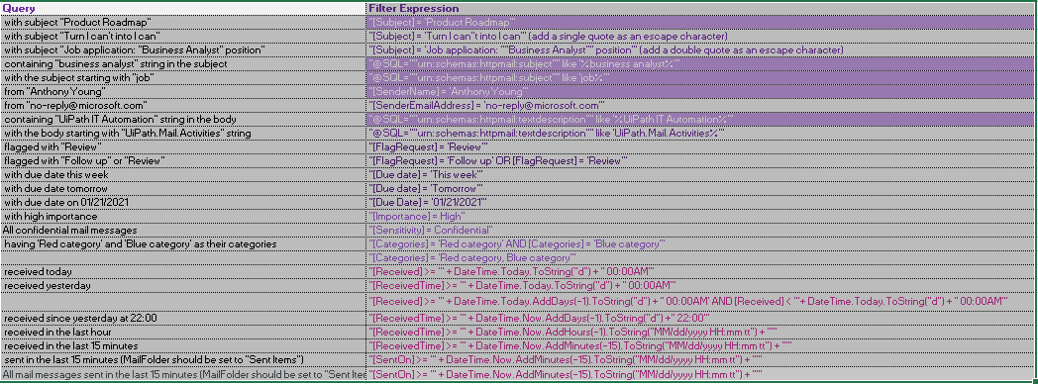

Steward Bank Outlook mail automation cheetsheet by Mcnamara Chiwaye
27, October 2021
+263772669086

